Slide 1


Slide 2
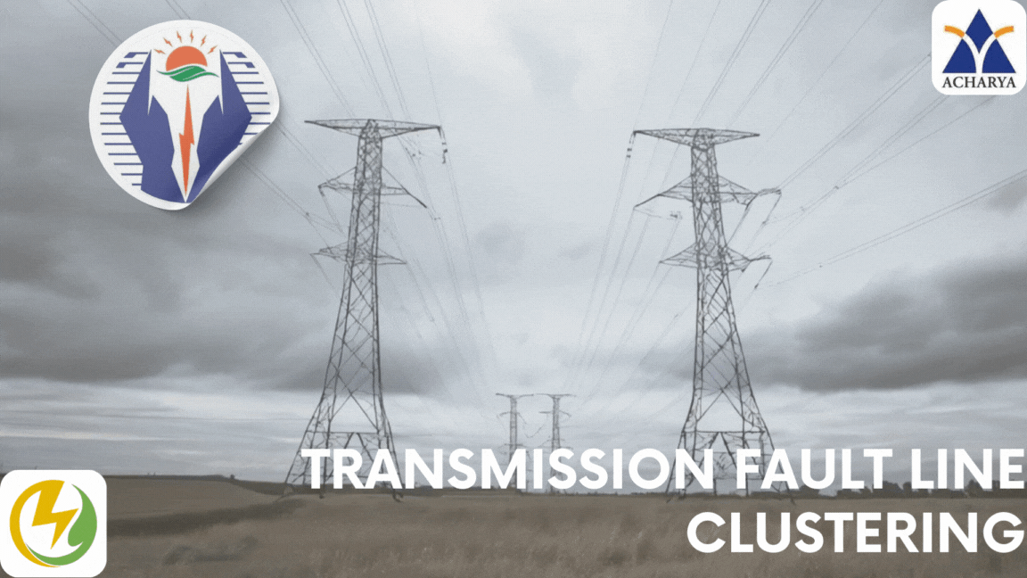

Slide 3
Transmission Fault Line Clustering
Using LSTM & TRANSFORMATION

